Slide 1
Conduction

Slide 2

In this Smart Lesson you will learn to:
Describe what is required for conduction to occur.
Explain how conduction relates to the particles in a substance.

Slide 3
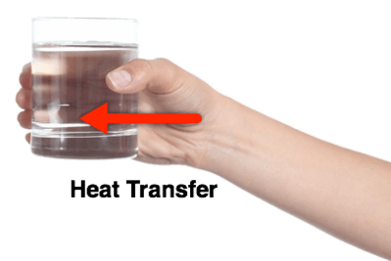
Have you ever held a glass of ice cold water and noticed that it also makes your hand cold?
This happens because heat flows from your hand to the cold glass.
This makes your hand cold but also makes the glass of water warm up.

Slide 4

This process of heat transfer is called conduction.
Conduction only occurs between two objects which are in direct contact. This means that they have to be touching.

Slide 5

When heat is transferred it always goes from the hotter object to the colder object.
This is why your warm hand got cold while the cold glass of water got warmer!

Slide 6
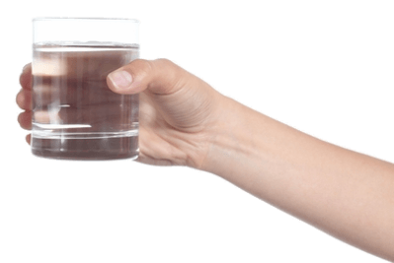
Heat transfer is faster when there is a larger difference in the temperatures of the two objects.
Imagine that you are holding one glass of water in each hand. The glass in your right hand has been in the fridge, while the glass in your left hand has been sitting in the Sun.

Slide 7
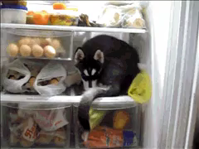
We would expect your right hand to get cold faster than your left hand.
This is because there is a larger temperature difference between your right hand and the glass of water, so heat transfer is faster.

Slide 8
Be careful!
One of the most common misconceptions about heat transfer is that cold travels from one place to another, for example you might think that ice cream makes your mouth cold as the cold is transferring from the ice cream to your mouth, but THIS IS WRONG!!!!
Cold is simply less thermal energy.
With the icecream, heat is being transferred from your mouth to the icecream, helping it melt. As your mouth is losing heat, if feels cold.
Make sure you really understand this before going on!

Slide 9
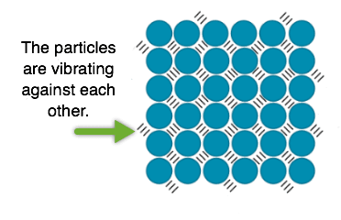
We already know that everything is made up of particles.
But did you know that these particles are constantly moving?
The particles in objects are all vibrating on the spot. The speed which they vibrate at depends on the temperature of the object.

Slide 10
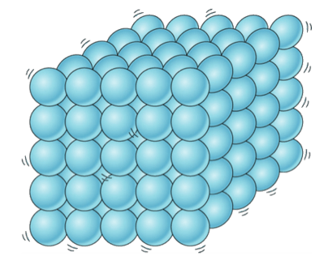
The particles in hot objects vibrate faster than the particles in cold objects.
It is this vibration that causes conduction to occur!

Slide 11

Let's use the example of a cool metal spoon being used to stir a hot cup of tea to explain how this works.
The particles in the cup of tea are vibrating very fast! As they vibrate, they nudge the slow-moving particles in the spoon.

Slide 12

As the particles in the spoon are nudged by the fast moving particles in the tea, they begin to vibrate faster.
This increases the temperature of the spoon. Voilà! Heat transfer has occurred.

Slide 13
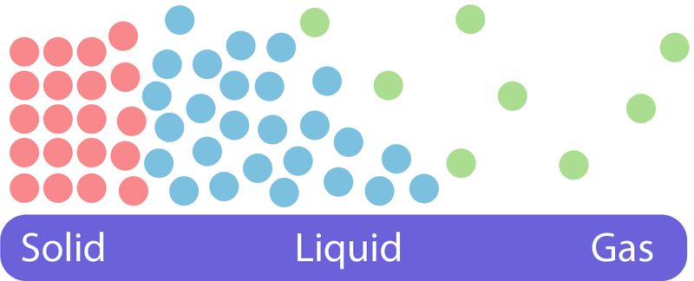
Conduction occurs quickest in solids as the particles are closest together.
As conduction requires direct contact between particles, this occurs rapidly in solids. There is some conduction in liquids, as the particles are still relatively close and very little in gases, as the particles are so far apart.
In fluids (liquids and gases) convection generally accounts for more heat transfer than conduction.

